Slide 1
Microsoft 365 Groups and classic site modernization
Speaker Name

Slide 3
Microsoft 365 Groups and Teams integration

Slide 4
Objective
After completing this lesson, you will:
What Microsoft 365 groups are and what they are designed to provide
How modern team sites are integrated with Microsoft 365 groups
Understand applications and services from which Microsoft 365 groups can be created
Know the process for connecting existing sites to an Microsoft 365 group
How to control the ability to connect existing sites to Microsoft 365 groups
How to modernize classic sites to the modern SharePoint experience (optional)
Notes:
Introduction
Site collections are essentially containers that hold content and information, other sites (also called subsites, webs, and subwebs), calendars, wikis, and much more. Therefore, properly planning site collections is a crucial aspect for SharePoint Online administration.
Objectives
After completing this lesson, you will understand:
What Microsoft 365 groups are and what they are designed to provide
How modern team sites are integrated with Microsoft 365 groups
Applications and services from which Microsoft 365 groups can be created
Connecting existing sites to a Microsoft 365 group
How to control the ability to connect existing sites to Microsoft 365 groups

Slide 5
Different business groups within an organization have different needs
Chat-based Workspace
Microsoft Teams
Mail & Calendar
Outlook
Voice, Video & Meetings
Skype
Co-Creating Content
Microsoft 365 ProPlus
Sites & Content Management
SharePoint
Enterprise Social
Yammer
Today’s Challenges
Siloed Apps
Friction across applications – multiple logins, difficulty sharing and discovering information
Wasted Time
Context switching between different apps drains attention and time
Shadow IT
Incomplete toolset can lead to inconsistent security, compliance and risk
Notes:
Objective: Show that companies are already using a diverse toolset, whether approved or shadow IT
When we peel back the covers and look at how companies are working today, we see a myriad of tools in use.
There’s the team of developers who is using team chat, the executives who use email and the HR team that helps the organization connect over enterprise social.
The reason multiple collaboration tools are in use is because every group is unique and has their own functional needs and workstyle. Some will use only email while others will live primarily in chat.
And if end users don’t find the IT approved option for their preferred tool, they’ll simply download the consumer grade version and that leads to a terrible user experience with multiple logins, difficulty sharing and no single view of content.
This poses a significant risk for organizations as shadow IT develops and there’s no way to uniformly manage a user’s access, ensure security or service compliance needs.

Slide 6
Microsoft 365 groups
Request distribution list (DL) for messaging
Get SharePoint Site for files
Create project plan
Manually manage permissions on content
Ramp up new team members based on previous group discussions
Apply & manage policies on content
Manually manage membership and access on distribution list (DL)
Collaboration
In the Past
Today
Self-service group in application of choice
Benefits for IT
Group identity & assets created in a single step
Centrally managed as a single object in Azure Active Directory (AAD)
Simplified permissions and access structure
Benefits for end users
All group assets created in a single step
Easy to manage independently
New members onboard quickly
Simplifies Collaboration
Notes:
Collaboration in the past has been difficult, with many steps and tickets required to obtain the resources needed to do your work as a team.
Microsoft 365 groups simplifies this process by providing many of the tools needed to collaborate in a single creation step.

Slide 7
Microsoft 365: Universal Toolkit for Teamwork
Outlook
SharePoint
Yammer
Office Apps
Teams
Email & Calendar
Intranets & Content Management
Connect Across
the Organization
Co-Author
Hub for Teamwork
Microsoft Graph
Suite-wide intelligence connecting people and content
Microsoft 365 groups
Single team membership across apps and services
Security and Compliance
Centralized policy management
Notes:
Universal Toolkit for team work
Good analogy is think of Microsoft 365 groups as a toolbox similar to the toolbox you have in your garage. You have a screw driver, hammer, wrench and other tools. When you go an work on a project in your garage you bring you’re the entire toolbox because you may need one tool at the beginning like a flat head screw driver but then need a star head for another piece of the project. Similarly, O365 Groups is that toolbox for collaboration it’s built with all the tools for the diverse needs / workstyles of each group bounded by a single team membership.

Slide 8

What are Microsoft 365 groups?
Microsoft 365 groups overview:
Groups in Microsoft 365 are provisioned in Azure Active Directory within your tenant.
Microsoft 365 groups can also be created from Outlook, Teams, Planner, Yammer, Stream, Power BI, and more.
Microsoft 365 groups let you choose a set of people that you wish to collaborate with and easily set up a collection of resources for those people to share without having to manage unique permissions on every resource used by the group.
Microsoft 365 group resources include a shared Outlook inbox, shared calendar, a document library, shared OneNote notebook, Planner, and more.
Notes:
NOTE: an Microsoft 365 group provisioned in Yammer will not have a shared mailbox.

Slide 9
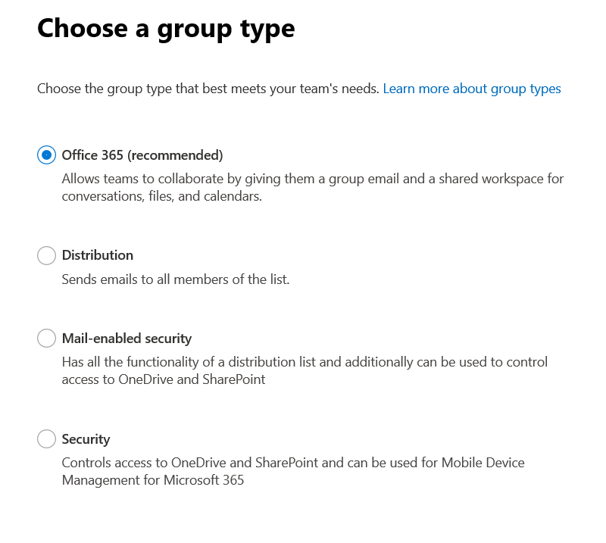
What type of group is good for me?

Slide 10
Connect to a Microsoft 365 Group
Classic (team) sites are not connected to a Microsoft 365 group, whereas modern team sites are.
Connecting your site to a Microsoft 365 group is an essential part of modernizing a site.
The connection to a Microsoft 365 group enables the site to consume other Microsoft 365 services such as Teams, Planner, and Outlook.
Two options to connect to a Microsoft 365 Group:
You can have each site owner do this on their behalf by using a wizard that can be launched from the user interface.
You can perform a bulk operation (known as a group-connection) in which you connect a Microsoft 365 group to a series of sites at one time. This option is preferred for enterprise customers because it enables you to control the configuration (public/private, site classification, alias name).
Notes:
For more information about connecting to a Microsoft 365 group and performing a group-connection, see Connect to a Microsoft 365 group.

Slide 11
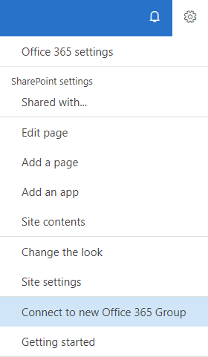
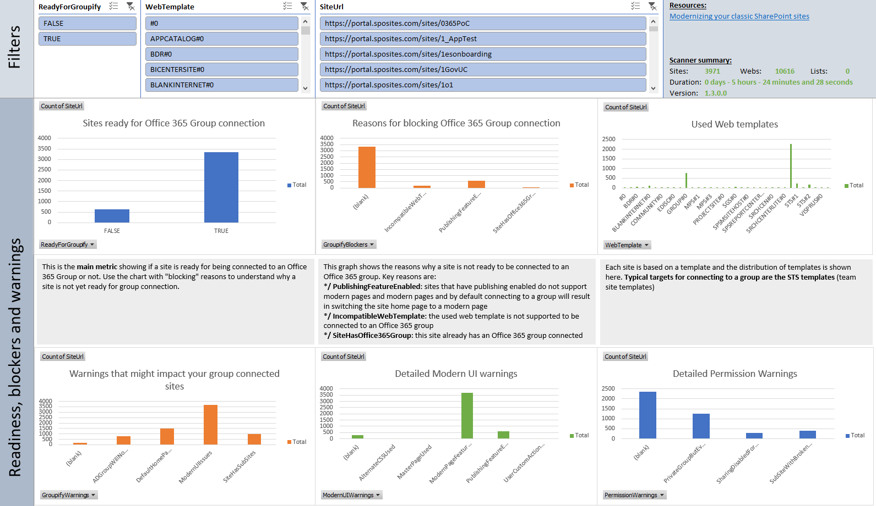
Connect to a Microsoft 365 group
How to go about it
SharePoint user interface
Programmatically
Learn, Analyze, Modernize
1
2
1
2
What happens?
A new Microsoft 365 group is created, and that group is connected to your site collection
A new modern home page is created on your site and set as the site's home page
The group's Owners are now the site collection administrators
The group's Owners are added to your site's Owners group
The group's Members are added to your site's Members group
Notes:
Connect to an Microsoft 365 group:
https://docs.microsoft.com/en-us/sharepoint/dev/transform/modernize-connect-to-office365-group

Slide 12
Connect a Microsoft 365 group to an existing SharePoint site
Programmatically connect a Microsoft 365 group
Step 1: Learn what group-connection does to your site
Getting familiar with what group-connection does to your site is important
Step 2: Analyze your site environment
understand which sites are ready to be group-connected, you can use the SharePoint Modernization Scanner to analyze your environment
Step 3: Modernize your sites
The bulk group-connect process consists of two steps:
Prepare and validate an input file that you'll use to drive the bulk group-connect process.
Run the bulk group-connect process. Sample PowerShell script HERE
Groupify steps :
Add current tenant admin as site admin when needed
Verify site template / publishing feature use and prevent groupify --> align with the logic in the scanner
Ensure no modern blocking features are enabled...if so fix it
Ensure the modern page feature is enabled
Optional: Deploy applications (e.g. application customizer)
Optional: Add modern home page
Call groupify API
Define Site Admins and Site owners as group owners
Define Site members as group members
Have option to "expand" site owners/members if needed
Remove added tenant admin and site owners from SharePoint admins
Remove added tenant admin from the Microsoft 365 group
Notes:
Step 1: Learn what group-connection does to your site
Getting familiar with what group-connection does to your site is important, and therefore we recommend that you do a manual group-connection for some test sites by using the user interface option. An important aspect to evaluate is whether you want to keep the newly created modern home page. As part of the modernization script, you'll be able to create a tailored home page, but if the default one serves your needs, that's the preferred option.
Step 2: Analyze your site environment
The user interface option shown in the previous section is not suitable if you want to group-connect hundreds of site collections. At that point, using an API to programmatically do this makes a lot of sense. But before doing that, it's best to verify which sites are ready to be group-connected because not all sites are suitable for this.
To help you understand which sites are ready to be group-connected, you can use the SharePoint Modernization Scanner to analyze your environment. This link contains all the details needed to use the scanner and information about what gets output by the scanner.

Slide 13
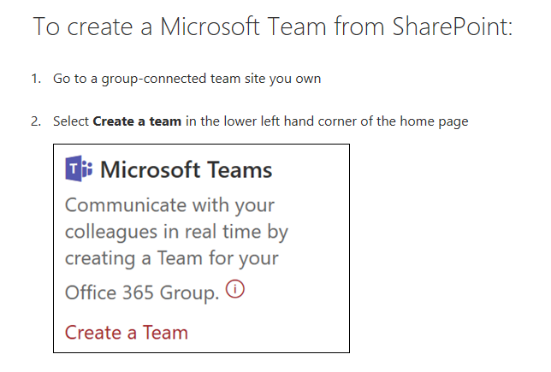
Connect to a Microsoft Team

Slide 14
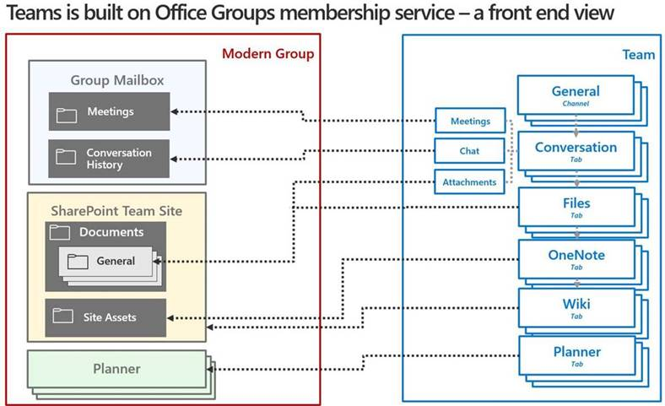

Slide 15
Modernize Classic Sites guide
Start with the Modernizing your classic SharePoint sites guide
Modernize Classic Sites Guide
Connect to a Microsoft 365 group
Modernize site branding
Connect to a Microsoft Team
Transform site pages
Notes:
https://docs.microsoft.com/en-us/sharepoint/dev/transform/modernize-classic-sites is the key entry point for all this content
Enable Modern Experiences:
The most visible aspect of a modern site is its modern user interface. Ensure the following tenant level setting is enabled in the SharePoint tenant admin center: SharePoint Lists and Libraries experience setting in the tenant admin center.
https://docs.microsoft.com/en-us/sharepoint/dev/transform/modernize-userinterface-lists-and-libraries
Connect to an Microsoft 365 Group:
https://docs.microsoft.com/en-us/sharepoint/dev/transform/modernize-connect-to-office365-group
Modernize Site Branding:
https://docs.microsoft.com/en-us/sharepoint/dev/transform/modernize-branding
Transform Site pages:
https://docs.microsoft.com/en-us/sharepoint/dev/transform/modernize-userinterface-site-pages
Connect to a Microsoft Team details covered here:

Slide 16
Fully leverage the modern user interface
The most visible aspect of a modern site is its modern user interface. If you haven't turned off the modern experience, certain pages appear in the modern user interface:
List and library pages for most lists and libraries
Site contents page
Site usage page
Recycle Bin pages
However, if you navigate your site, you will notice that the following pages still use the classic user interface:
Home page and all other site pages (wiki pages and/or web part pages)
List and library pages for certain lists and libraries
To maximize the use of the modern user interface for your site pages and list and library pages, see Modernize the user interface.
To learn more about how to unblock your lists and libraries when using the modern user interface, see Maximize use of modern lists and libraries.
You will also need to modernize your customizations as explained in Modernize customizations.
Tools to Modernize
Notes:
To maximize the use of the modern user interface for your site pages and list and library pages, see Modernize the user interface.
To learn more about how to unblock your lists and libraries when using the modern user interface, see Maximize use of modern lists and libraries.
You will also need to modernize your customizations as explained in Modernize customizations.

Slide 17



Step 1: Identify and Educate Stakeholders
Change Management and Governance teams
Key Business Stakeholders
Customization team and developers
SharePoint Administrators
Notes:
Key business stakeholders - The modern user interface must meet the needs of the business user, and the key business stakeholders should be advocates of this change. Granting them access to a playground environment and closely working with them will help them understand what works well and what doesn't. Later on, these key business stakeholders will play a crucial role in helping your end-users adopt the modern user interface.
Customization team and developers - Because customizations built in the past may no longer work in the modern user interface, this team needs to be available to redesign those customizations.
SharePoint administrators - The admins will be the ones that enable the modern user interface across your tenant and its sites.
Change management and governance teams - If these teams exist in your organization, they should be looped in as well because switching from the classic user interface to the modern user interface impacts change for users, and might require an update of internal training materials.

Slide 18
Step 3: Modernize your site collections--Customizations
Replace
Replace incompatible customizations with equivalents that work in a modern user interface. Following are some samples. For more information, see Modernize customizations.
Replace
Replace JSLink with a column formatter or with a SharePoint Framework Field Customizer extension.
Replace
Replace existing first-party web parts with SharePoint Framework web parts in case there's no out-of-the-box modern web part available that provides similar capabilities.
Replace
Replace JavaScript embedding via user custom actions with a SharePoint Framework Application Customizer extension.
Replace
Replace list commands (user custom actions) with SharePoint Framework ListView Command Set extensions.

Slide 19

Step 4: Modernize your site collection-Communications
Communicate to your end users about the completed changes; the site will work differently in a modern version, so your users need to be aware of that.
Leverage materials available in the FastTrack Resource Hub
Notes:
For more information on communication tools and resources, leverage the End User Awareness materials available in FastTrack Resource Hub

Slide 20
Knowledge Check
Where are Microsoft 365 groups provisioned?
Can an existing classic team site be connected to a Microsoft 365 group?
Does a Microsoft 365 group include a modern team site?
They are provisioned in Azure AD
Yes
Yes. All Microsoft 365 groups include a modern team site resource that is used for content (file and OneNote) storage for the group

Slide 21
Summary
In this lesson, you learned about:
An overview of what Microsoft 365 groups are and what they are designed to provide
How modern team sites are integrated with Microsoft 365 groups
Applications and services from which Microsoft 365 groups can be created
Connecting existing sites to a Microsoft 365 group

Slide 22
Lab M4
Exercise 1 - Microsoft 365 Groups integration

